Slide 1
Image Upscaling using ESRGAN and Autoencoder
Presented by: Gautam Chauhan, Suyash Chaudhary

Slide 2

Introduction
Problem Statement
Dataset: BSD200
Models: ESRGAN and Autoencoder

Slide 3
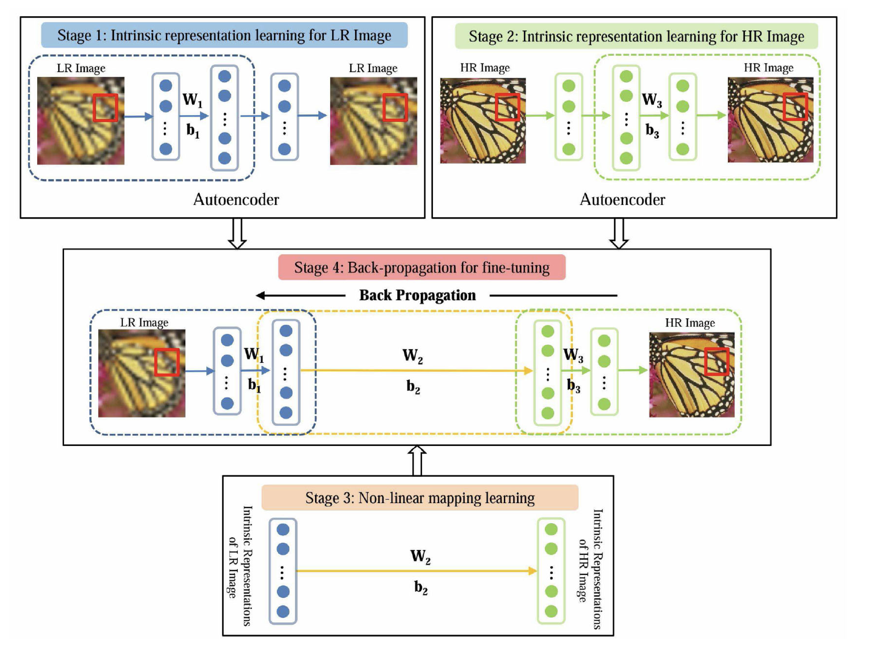
Autoencoder
Image Courtesy: Zeng et al. (DOI: 10.1109/TCYB.2015.2501373)

Slide 4
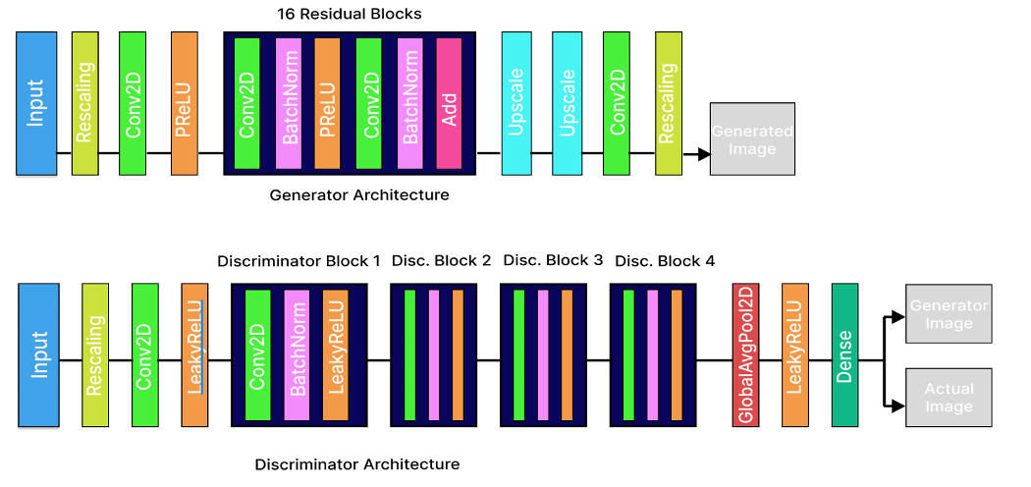
ESRGAN

Slide 5
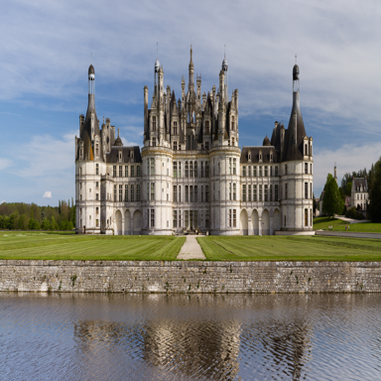
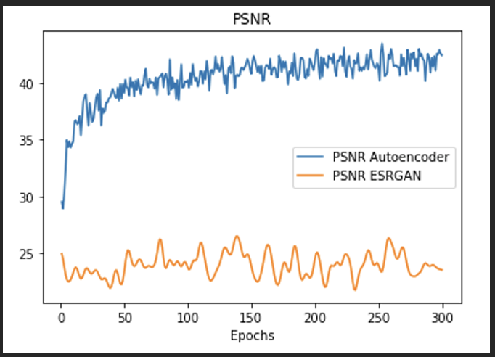

Results

Slide 6
Thank you

